Slide 1
User Permissions
Phil Daniels

Slide 2
What are user permissions?
Permissions allow your application to access certain security features of your phone.
Some permissions will need explicit consent from the user, some will not.
If the device is running Android 6.0 (API level 23) or higher, and the app's targetSdkVersion is 23 or higher, the app requests permissions from the user at run-time.
If the device is running Android 5.1 (API level 22) or lower, or the app's targetSdkVersion is 22 or lower, the system asks the user to grant the permissions when the user installs the app

Slide 3
How do I ask permission for something?
In your Android Manifest, simply add:
<uses-permission android:name="android.permission.X" />
Where X is the permission you want to add
Permissions are constant Strings, in ALL_CAPS_AND_UNDERSCORES

Slide 4
When will apps ask a user for a permission?
A particular permission may be enforced at a number of places during your program's operation:
At the time of a call into the system, to prevent an application from executing certain functions.
When starting an activity, to prevent applications from launching activities of other applications.
Both sending and receiving broadcasts, to control who can receive your broadcast or who can send a broadcast to you.
When accessing and operating on a content provider.
Binding to or starting a service.

Slide 5
Permissions Change!!!
Over time, new restrictions may be added to the platform
Your app must request a permission that it previously did not need
For example, the WRITE_EXTERNAL_STORAGE permission was added in API level 4 to restrict access to the shared storage space
NOTE: Google play will list all permissions you add to your app, even if your code never uses them

Slide 6
“Dangerous” vs “Normal” Permissions
Normal permissions cover areas where your app needs to access data or resources outside the app's sandbox, but where there's very little risk to the user's privacy or the operation of other apps.
Dangerous permissions cover areas where the app wants data or resources that involve the user's private information, or could potentially affect the user's stored data or the operation of other apps
Like mentioned earlier, Dangerous Permissions require explicit user consent

Slide 7
Dangerous Permissions: One grants many…
Permissions are grouped together (ex: Calendar, Contacts, Phone)
If your app gets a Dangerous Permission granted from the user, your app can get automatic access to any other permission it is grouped with.
Ex: If the user grants ACCESS_FINE_LOCATION, if the app asks for ACCESS_COARSE_LOCATION, the system will automatically grant it

Slide 8

Now For the Fun Part...
User and System permitting, what screwy permissions can our apps access?
Here are some of my favorites...

Slide 9
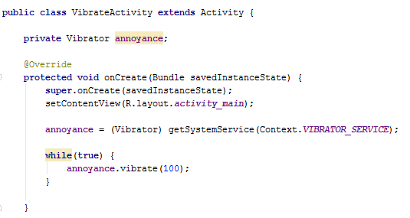
Vibration
<uses-permission android:name="android.permission.VIBRATE" />

Slide 10
Contacts and SMS
<uses-permission android:name="android.permission.READ_CONTACTS" />
<uses-permission android:name="android.permission.SEND_SMS" />

Slide 11
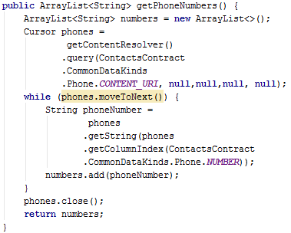
Contacts and SMS: Getting every phone #

Slide 12
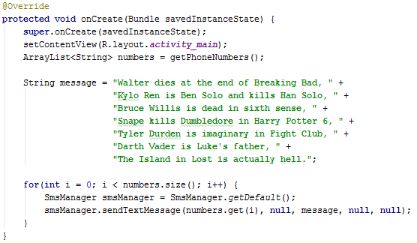
Contacts and SMS: Sending texts out

Slide 13
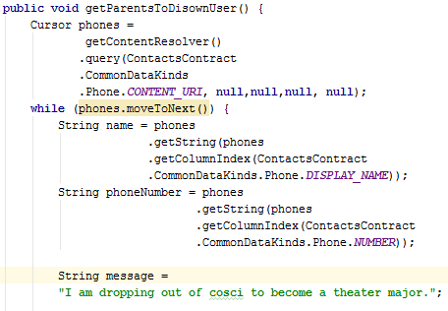
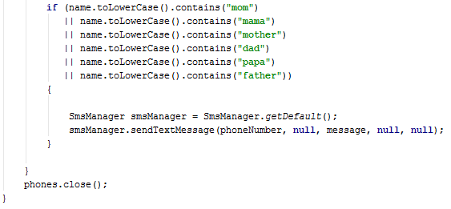
Contacts and SMS: Sending texts out
What if we wanted to send a text to . . . Mom and Dad?

Slide 14
Wallpaper
<uses-permission android:name="android.permission.SET_WALLPAPER" />

Slide 15
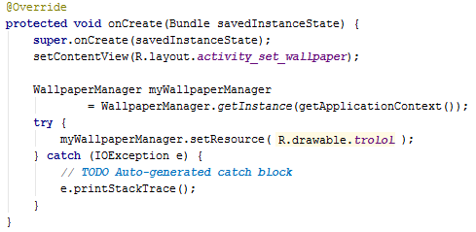
Changing the User’s Wallpaper

Slide 16
Works Cited
http://developer.android.com/guide/topics/security/permissions.html#permissions
http://developer.android.com/reference/android/Manifest.permission.html
http://stackoverflow.com/questions/2356084/read-all-contacts-phone-numbers-in-android
http://karanbalkar.com/2013/07/programmatically-vibrating-android-device/
http://stackoverflow.com/questions/10160267/how-to-set-image-as-wallpaper-programmatically

